Slide 1
Chemical and Biological Materials
Unit-3
Nanocomposites
B.Tech Sem I

Slide 2
Syllabus Unit: Nanocomposites
Introduction
Fabrication
Carbon-metal nanocomposites,
Bio-inspired nanocomposites.
Application of Nanocomposites in
Aerospace; Coating, Mechanical, Electrical & Electronics, Fuel cell, thermoelectric device, thermal interface materials (thermal management of computer devices).

Slide 3
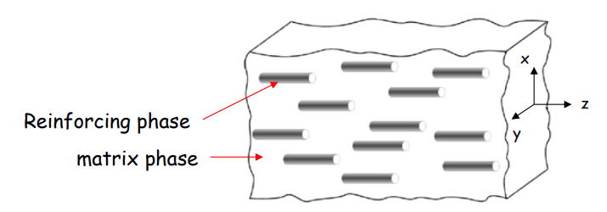
Nanocomposites-Introduction
Composite Materials:
Composites are combinations of two materials in which one of the material is called the reinforcing phase, is in the form of fibers, sheets, or particles, and is embedded in the other material called the matrix phase.
Typically, reinforcing materials are strong with low densities while the matrix is usually a ductile or tough material. If the composite is designed and fabricated correctly, it combines the strength of the reinforcement with the toughness of the matrix to achieve a combination of desirable properties not available in any single conventional material.

Slide 4
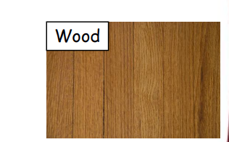
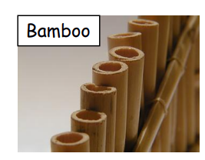
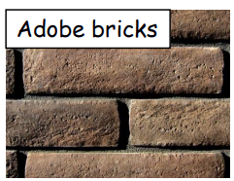
Nanocomposites-Introduction
Natural composite materials in the world
• Wood is a good example of a natural composite, combination of cellulose fiber and lignin. The cellulose fiber provides strength and the lignin is the "glue" that bonds and stabilizes the fiber.
• Bamboo is a very efficient wood composite structure. The components are cellulose and lignin, as in all other wood, however bamboo is hollow. This results in a very light yet stiff structure. Composite fishing poles and golf club shafts copy this natural design.
• The ancient Egyptians manufactured composites! Adobe bricks are a good example. The combination of mud and straw forms a composite that is stronger than either the mud or the straw by itself.

Slide 5
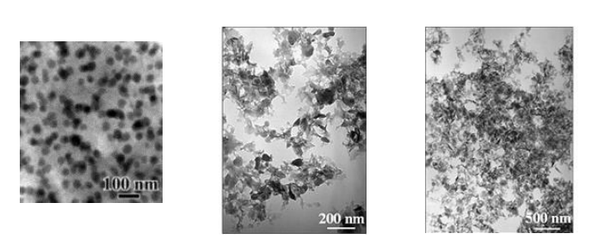
Nanocomposites-Introduction
What are Nanocomposites:
A broad class of materials, with microstructures modulated in zero to three dimensions on length scales less than 100 nm.
Materials with atoms arranged in nanosized clusters, which become the constituent grains or building blocks of the material.
Any material with at least one dimension in the 1-100 nm range.
Nanocomposite means nanosized particles (i.e metals, semiconductors, dielectric materials, etc) embedded in different matrix materials (ceramics, glass, polymers, etc).

Slide 6
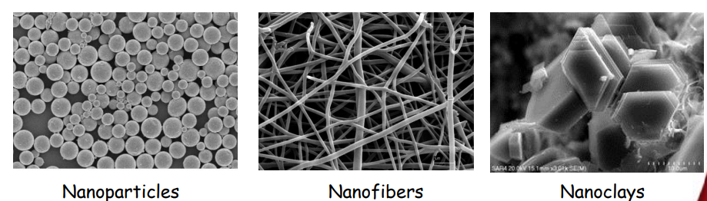
Nanocomposites-Introduction
What are Nanocomposites:
The definition of nanocomposite materials has broadened significantly to encompass a large variety of systems such as zero-dimensional, one-dimensional, two dimensional, three-dimensional (3D) and amorphous materials made of distinctly dissimilar components and mixed at the nanometre scale.
Constituents have at least one dimension in the nanometer scale.
– Nanoparticles (Three nano-scale dimensions)
– Nanofibers (Two nano-scale dimensions)
– Nanoclays (One nano-scale dimension)

Slide 7
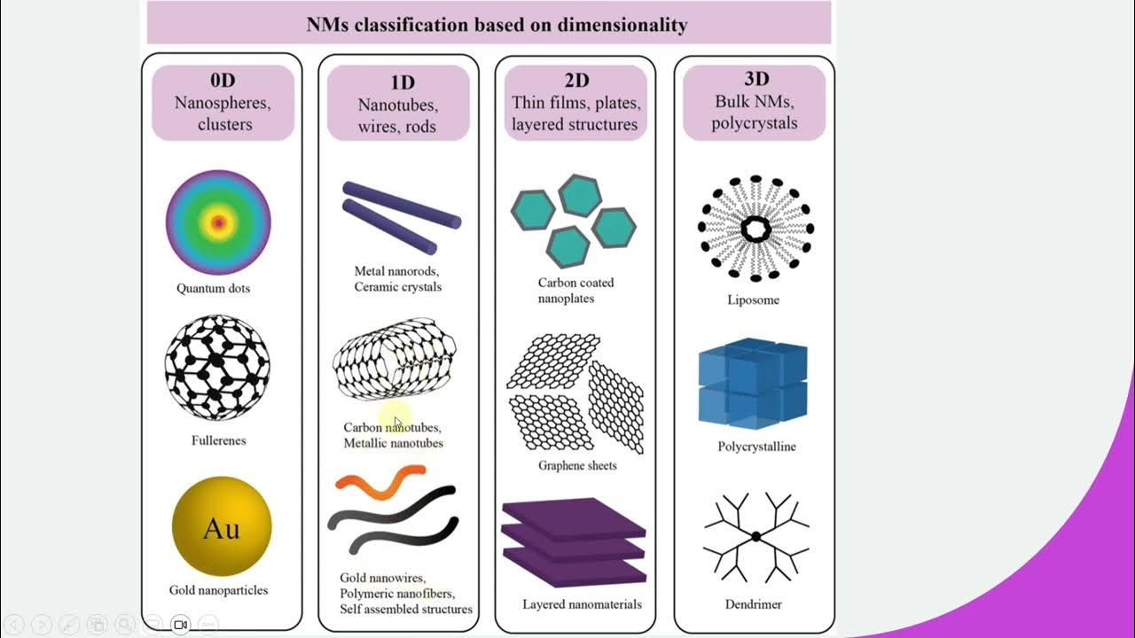

Slide 8
Nanocomposites-Properties
Why nanocomposites ? → Multifunctionality
Nanocomposites can be made with a variety of enhanced physical, thermal and other unique properties. They have properties that are superior to those of conventional microscale composites, and they can be synthesised using simple and inexpensive techniques. Applications could be as diverse as biological implant materials, electronic packages and automotive or aircraft components.
While industry is seeking materials to meet difficult challenges with unique properties, there is no ‘rule of mixture’ to identify how to mix multiple nanomaterials in a composite structure and to achieve all the required properties. Varieties of nanocomposites have been synthesised and characterised, and their applications have been studied

Slide 9
Nanocomposites-Properties
Why nanocomposites ? → Multifunctionality
Light transmission characteristics particle size dependent
Improved mechanical properties (e.g. strength, modulus and dimensional stability);
Reduced permeability to gases, water and hydrocarbons;
Improved thermal stability and heat distortion temperature (HDT);
Reduced thermal expansion coefficient;
Enhanced flame retardancy;
Reduced smoke emissions;
Improved chemical resistance;
Better surface appearance;
Higher electrical conductivity and
Improved optical clarity.

Slide 10
Nanocomposites-Properties
Thermal Properties:
The nanocomposite with good thermal conductivity have multiple applications, such as printed circuit boards, thermal interface materials, heat sinks, connectors and high-performance thermal management systems.
Mechanical Properties:
The mechanical properties of nanocomposites, such as tensile strength, elongation and modulus, are affected by the surface morphology and the material used for production. The improvement of mechanical properties of polymer nanocomposite can be attributed to the good affinity between the polymer and nanofiller along with the high rigidity and high aspect ratio of nanofillers.
Barrier Properties:
The nanocomposites have very good barrier property against gases because of their high aspect ratio and by the creation of a tortuous path that retards the progress of the gas molecules through the matrix resin. Inside the nanocomposite structure, the presence of the filler introduces a tortuous path for diffusing penetrants. The permeability is reduced because of the longer diffusive path that the penetrants must travel in the presence of filler.

Slide 11
Nanocomposites-Properties
Electrical Properties:
The electrical properties of nanocomposites depend on several factors, such as aspect ratio, dispersion and alignment of the conductive nanofillers in the structure. The nanocomposites containing CNTs have superior electrical properties (high energy densities and low driving voltages). The conductive nanocomposite has found applications in many fields such as electrostatic dissipation, electrostatic painting, electromagnetic interference shielding, printable circuit wiring and transparent conductive coating.

Slide 12
Nanocomposites-Applications
Nanocomposites are promising for use in various areas such as automotive, aerospace, defense, and biomedicine fields. Nanocomposites allow design and characteristic choices that are impossible with conventional composites.
Based on their light weight and multifunctionality, nanocomposites cater the needs without compromising aesthetics and comfort of textiles.
In smart textiles, nanocomposites take part in sensors, actuators, mediators, biosensors, thermoregulation, energy storing, and harvesting elements, among others. Nanocomposites are especially promising for sophisticated niche areas.
Nanocomposites have already started to be used in a number of applications; nevertheless, there are still various potential areas where nanocomposites can be utilized in the future.

Slide 13
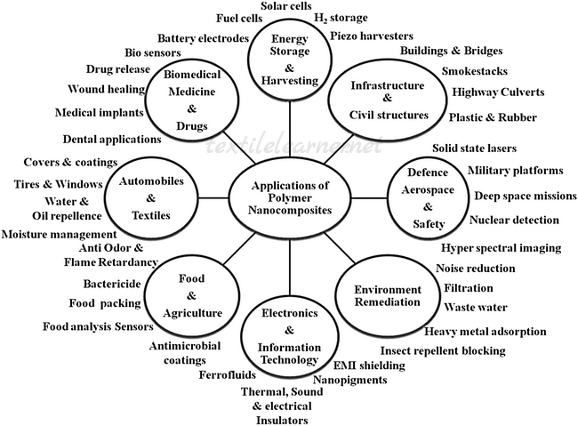
Nanocomposites-Applications

Slide 14
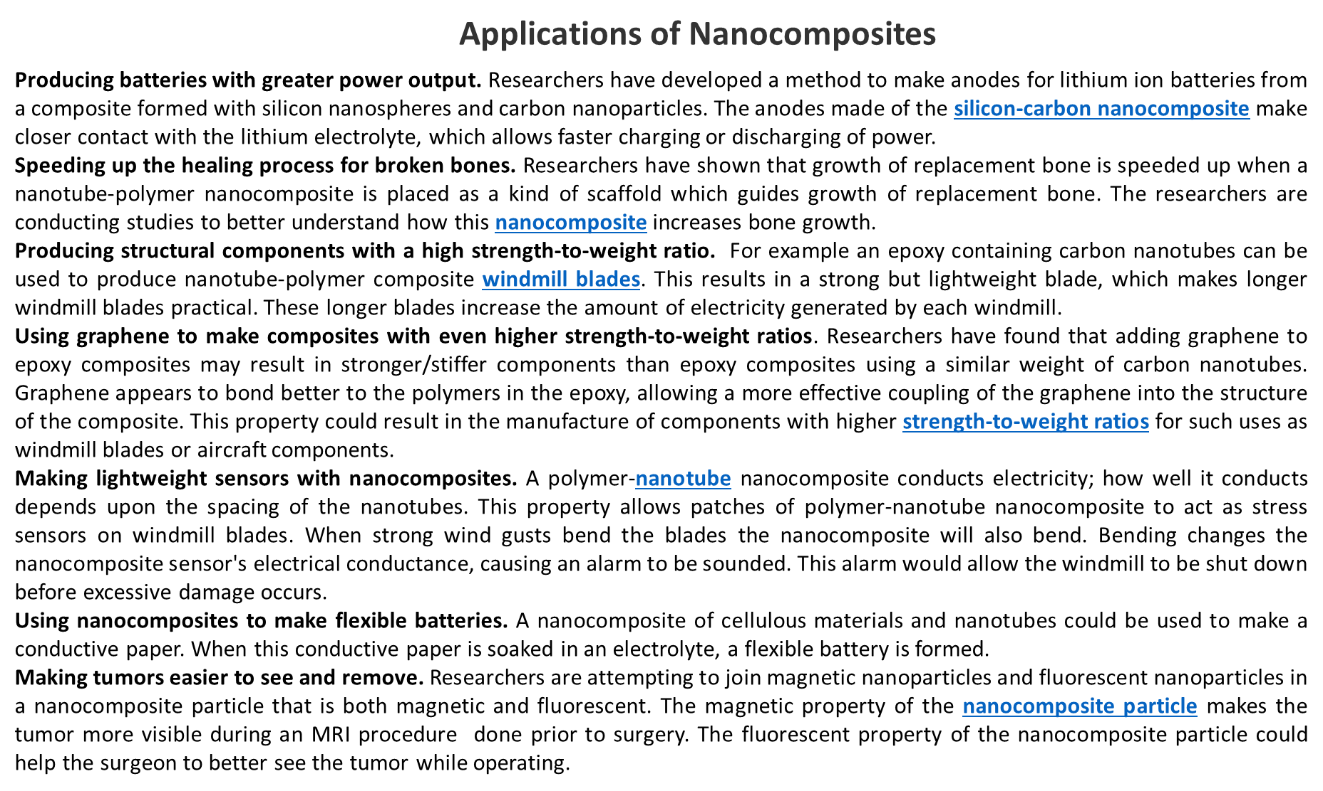

Slide 15
Fabrication-nanocomposites
Solids with nano size particles cannot be prepared by the traditional methods. All the alternative methods – for example hydrothermal, sol-gel, Pechini, chemical vapour deposition (CVD) and microwave (MW) address this problem by achieving atomic-scale mixing of reactants, in gas, liquid or even solid phases.
Most of these are low-temperature methods, although final firing may be required at high temperatures, especially for ceramic-type products.

Slide 16
Fabrication-Pechini
Pechini method
It involves the formation of a polymer precursor solution that contains metal ions, followed by controlled decomposition to obtain a ceramic or metal oxide nanocomposite. This method allows for precise control over composition, particle size, and morphology of the nanocomposite.
During the synthesis, metal salts or alkoxides are introduced into a citric acid solution with ethylene glycol.
The formation of citric complexes is believed to balance the difference in the individual behaviour of ions in solution, which results in a better distribution of ions and prevents the separation of components at later stages.
The polycondensation of ethylene glycol and citric acid starts above 100°C, resulting in polymer citrate gel formation.
When the temperature of heating exceeds 400°C, oxidation and pyrolysis of the polymer matrix begins, which leads to the formation of an amorphous oxide and/or carbonate precursor.
Further heating of this precursor results in the formation of the required material with a high degree of homogeneity and dispersion.

Slide 17
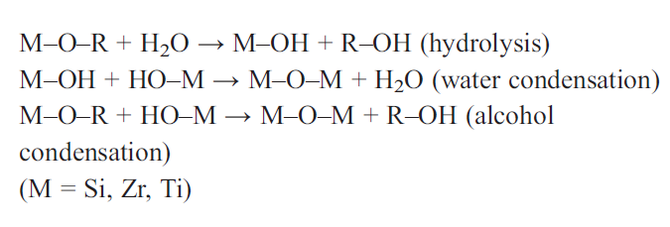
Fabrication-Sol Gel
Sol Gel method
The sol-gel process is a synthesis route consisting of the preparation of a sol and successive gelation and solvent removal.
The sol-gel process consists of chemical transformation of a liquid (the sol) into a gel and with subsequent post-treatment and transition into a solid oxide material.
The main benefits of sol-gel processing are the high purity and the uniform nanostructure achievable at low temperatures. The sol-gel process allows to synthesise ceramic materials of high purity and homogeneity by preparation techniques that are different from the traditional process of fusion of oxides.

Slide 18
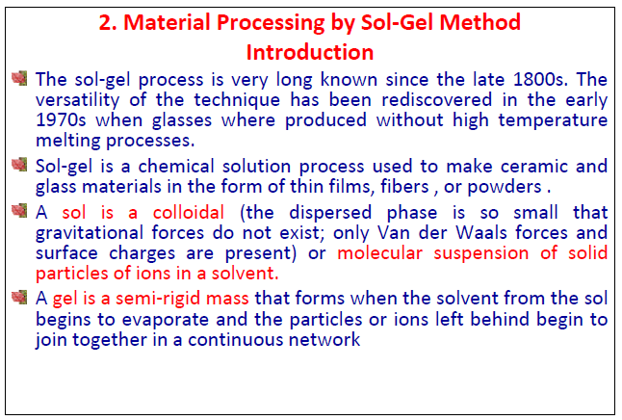
Fabrication-Sol Gel

Slide 19
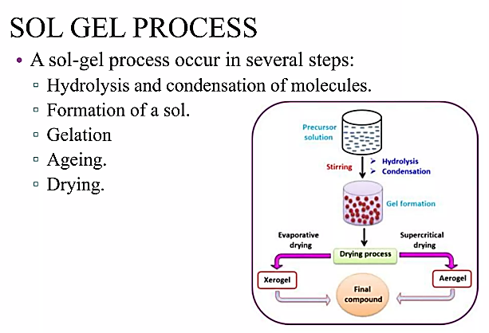
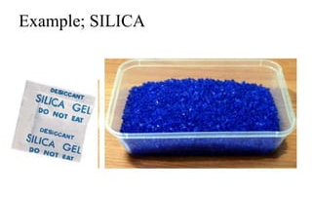
Fabrication-Sol Gel

Slide 20
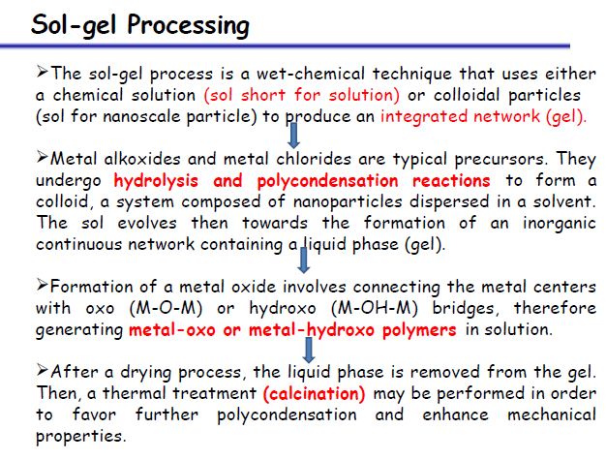
Fabrication-Sol Gel

Slide 21
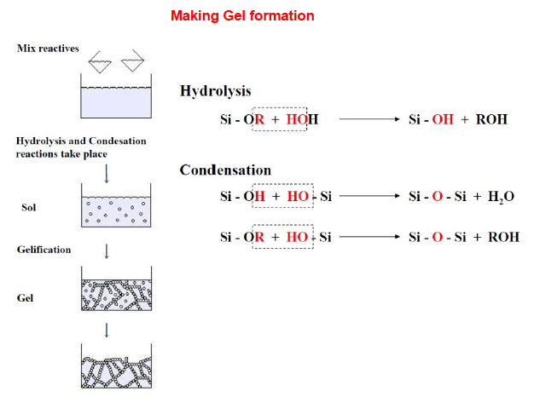
Fabrication-Sol Gel

Slide 22
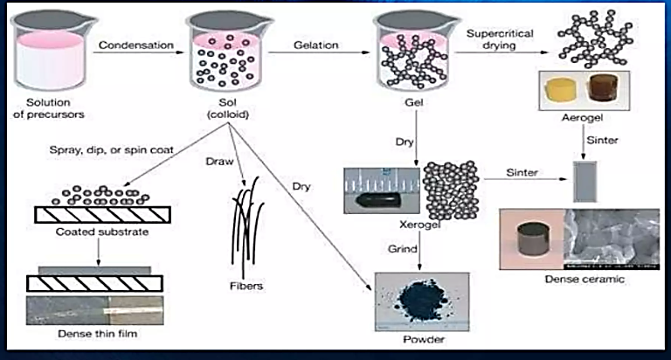
Fabrication-Sol Gel

Slide 23
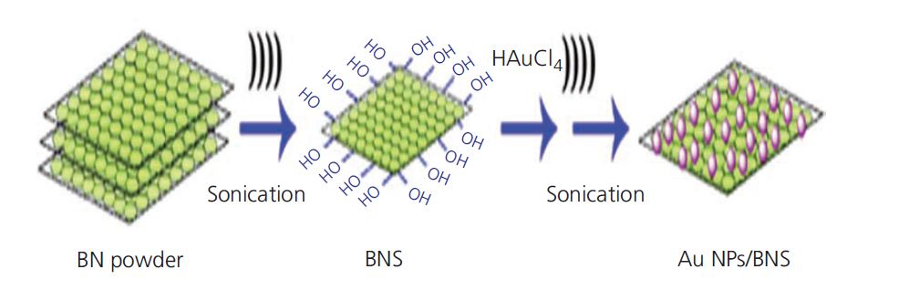
Fabrication-Sonochemical
Sonochemical method
The sonochemical method, also known as ultrasonic-assisted synthesis, is a technique used for the fabrication of nanocomposites. It involves the use of high-frequency ultrasound waves to induce chemical reactions or physical processes in a solution containing precursor materials. This method enables the production of nanoscale materials with controlled size, shape, and composition.
Sonication is a simple, multipurpose technique used in the preparation of nanomaterials, which is based on acoustic cavitation, namely the formation, growth and implosive collapse of bubbles in a liquid.

Slide 24
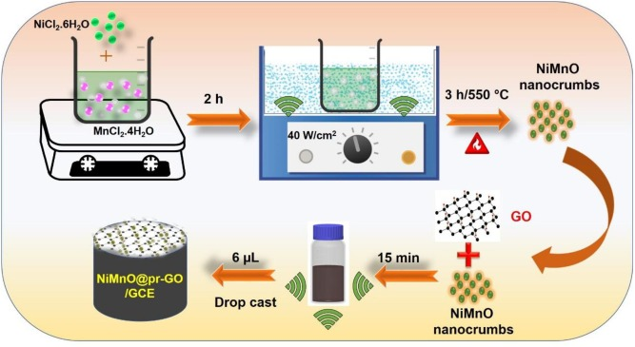
Fabrication-Sonochemical

Slide 25
Fabrication-Thermal spray
Fabrication-Thermal spray method
This is an effective technique because agglomerated nanocrystalline powders are melted, accelerated against a substrate and quenched very rapidly in a single step.
This rapid melting and solidification promotes the retention of a nanocrystalline phase and even amorphous structure. Retention of the nanocrystalline structure leads to enhanced wear behaviour, greater hardness and sometimes a reduced coefficient of friction compared to conventional coatings.
Thermal spray is a versatile manufacturing process used to apply coatings or create free-standing parts by projecting small molten or semi-molten particles onto a substrate. When used for the fabrication of nanocomposites, this process involves incorporating nanoscale materials into the thermal spray feedstock to enhance the properties of the resulting coatings or parts.

Slide 26
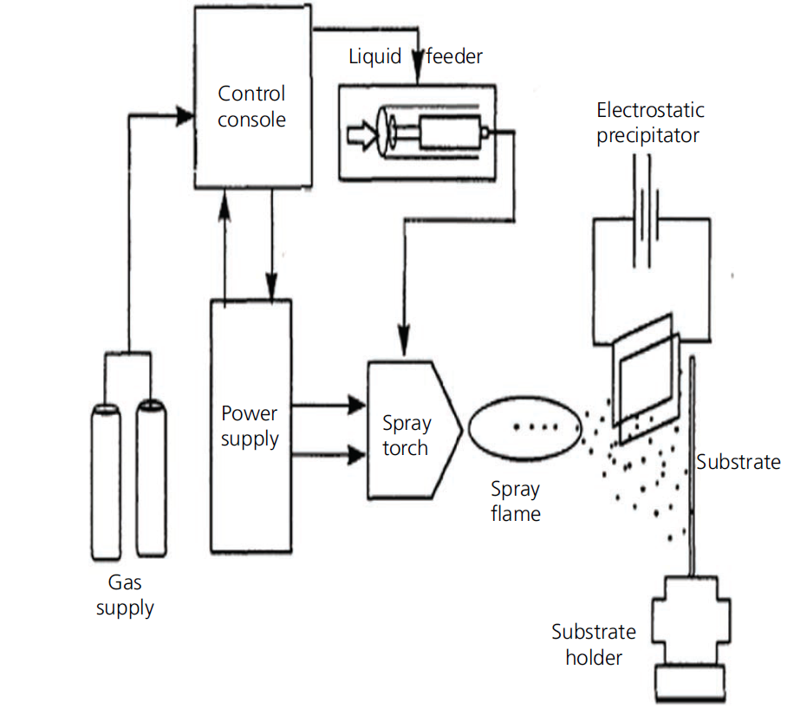
Fabrication-Thermal spray

Slide 27
Fabrication-Microwave Synthesis
Fabrication-Microwave Synthesis method
MW synthesis is the application of MW radiation in forming desired products. MWs act as high-frequency electric fields and will generally heat any material containing mobile electric charges, such as polar molecules in a solvent or conducting ions in a solid.
Polar solvents are heated as their component molecules are forced to rotate with the field and lose energy during collisions.
Conventional heating usually involves the use of a furnace or oil bath, which heats the walls of the reactor by convection or conduction. The core of the sample takes a much longer time to achieve the target temperature – for example, heating a large sample of ceramic bricks. MW heating is able to heat the target compounds without heating the entire furnace or oil bath, which saves time and energy.

Slide 28
Fabrication-Microwave Synthesis
Fabrication-Microwave Synthesis method
MW synthesis is the application of MW radiation in forming desired products. MWs act as high-frequency electric fields and will generally heat any material containing mobile electric charges, such as polar molecules in a solvent or conducting ions in a solid.
Polar solvents are heated as their component molecules are forced to rotate with the field and lose energy during collisions.
Conventional heating usually involves the use of a furnace or oil bath, which heats the walls of the reactor by convection or conduction. The core of the sample takes a much longer time to achieve the target temperature – for example, heating a large sample of ceramic bricks. MW heating is able to heat the target compounds without heating the entire furnace or oil bath, which saves time and energy.

Slide 29
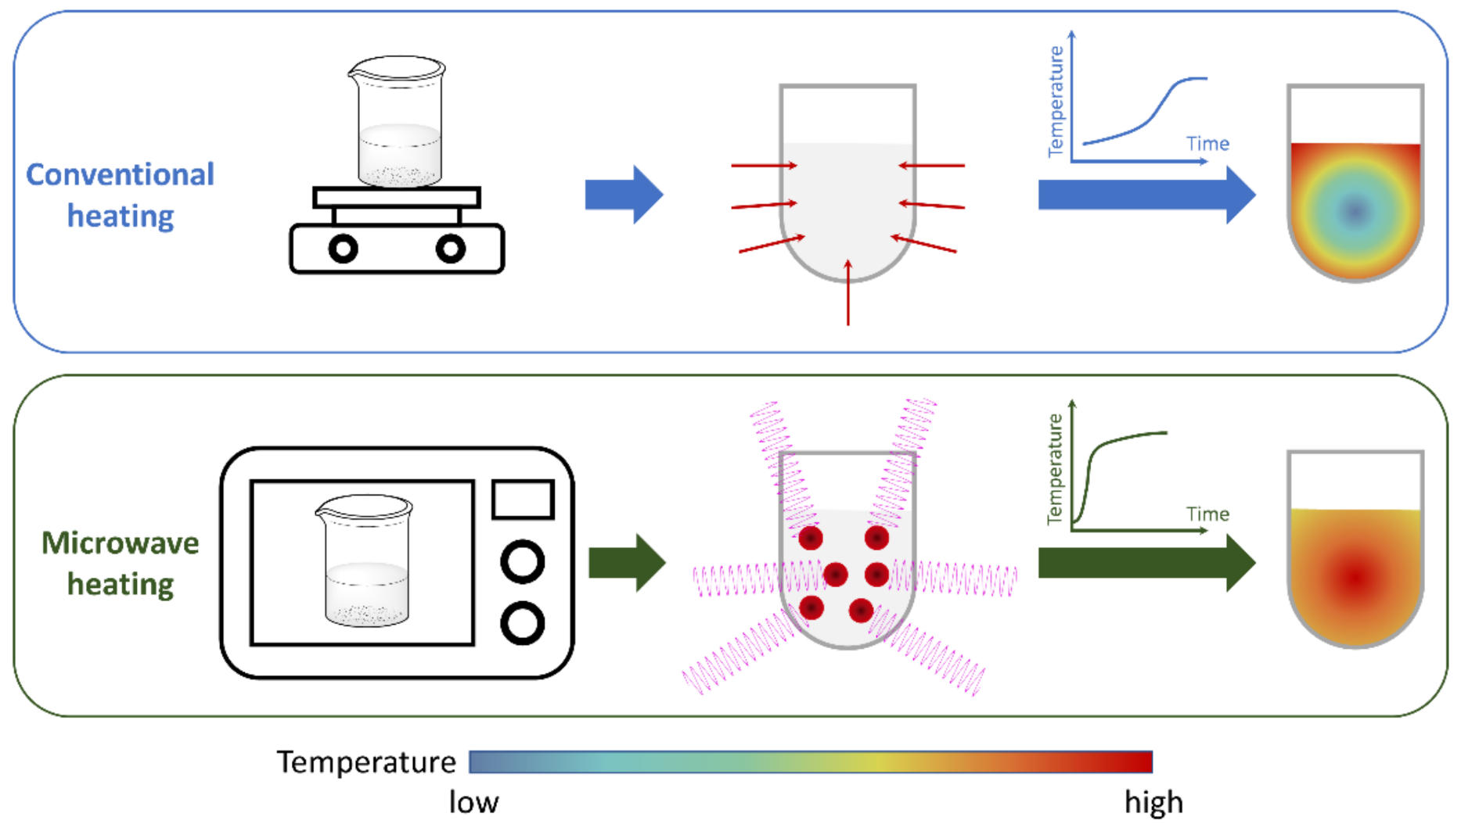
Fabrication-Microwave Synthesis

Slide 30
Fabrication-Electrochemical Synthesis
Electrochemical synthesis of nanocomposites
Among the numerous synthesis routes employed to grow zinc oxide (ZnO) nanostructures, electrochemical synthesis has been recognised as a potential technique because it is simple, economical and easy to scale up to industrial level.45 Moreover, it facilitates on-site doping and/or decorating of the nanostructures.
Hydrothermal method
Hydrothermal reactions are usually performed in closed vessels. The reactants are either dissolved or suspended in a known amount of water and are transferred to acid digestion reactors or autoclaves. Under hydrothermal conditions, reactants that are otherwise difficult to dissolve can go into solution and reprecipitate. Hydrothermal processing is a non-conventional method to obtain nanosize inorganic materials at high temperature.

Slide 31
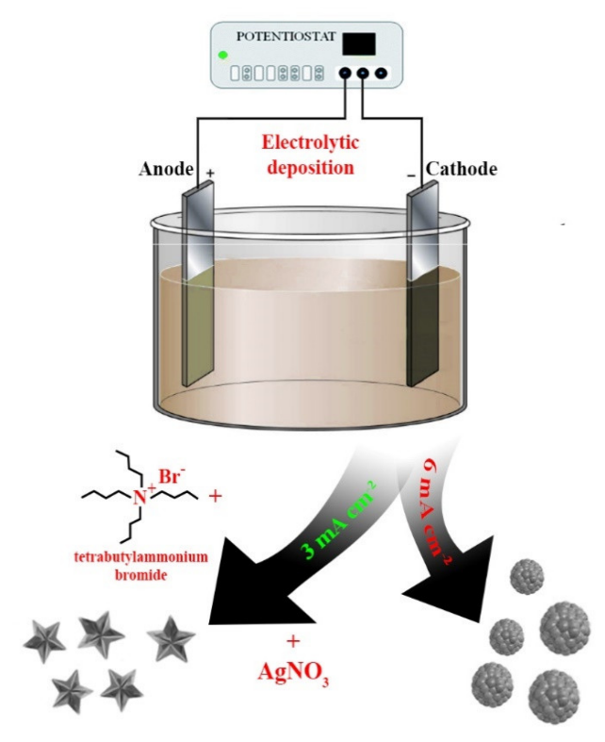
Fabrication-Electrochemical Synthesis
Electrochemical synthesis of nanocomposites
Among the numerous synthesis routes employed to grow zinc oxide (ZnO) nanostructures, electrochemical synthesis has been recognized as a potential technique because it is simple, economical and easy to scale up to industrial level. Moreover, it facilitates on-site doping and/or decorating of the nanostructures.
Electrochemical deposition is a technique that has been widely used for the synthesis of metal nanoparticles. Electrochemical deposition occurs at the interface of an electrolyte solution containing the metal to be deposited and an electrically conductive metal substrate.
Electrochemical synthesis primarily focuses on using anodic dissolution where the electrodes (oxidation of electrodes) serve as metal ions. With the support of an electrolyte, an electrode was placed inside a container with an organic linker solution.

Slide 32
Fabrication-Electrochemical Synthesis
Hydrothermal method
Hydrothermal reactions are usually performed in closed vessels. The reactants are either dissolved or suspended in a known amount of water and are transferred to acid digestion reactors or autoclaves. Under hydrothermal conditions, reactants that are otherwise difficult to dissolve can go into solution and re-precipitate. Hydrothermal processing is a non-conventional method to obtain nanosize inorganic materials at high temperature.
The hydrothermal method refers to the use of an aqueous solution as a reaction system in a special closed reaction vessel to create a high-temperature, high-pressure reaction environment by heating the reaction system and pressurizing it (or the vapor pressure generated by itself).

Slide 33
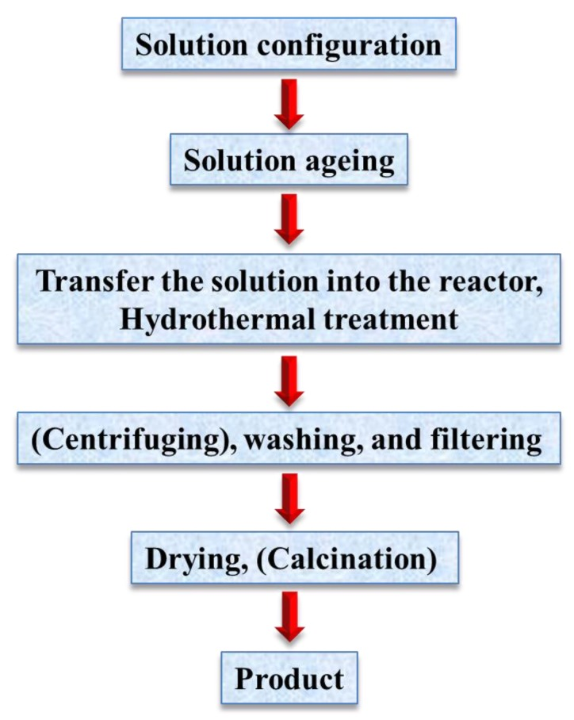
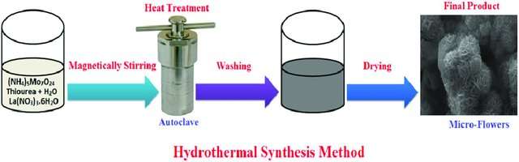
Fabrication-Electrochemical Synthesis

Slide 34
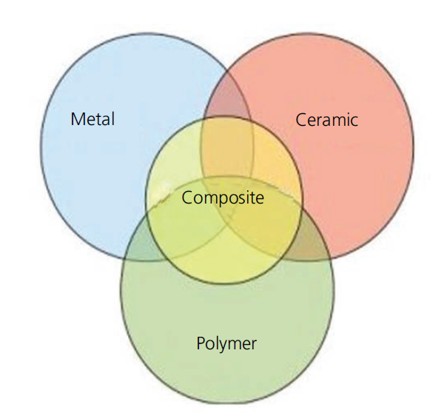
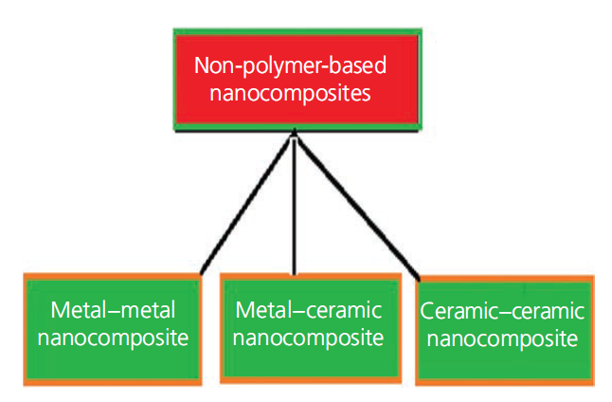
Classification of Nanocomposites
Composites can be defined as an ensemble of two phases, blended/mixed to obtain the desired properties, tailor-made for specific applications. Nanocomposites constitute a subgroup of this bigger domain of multifunc­tional materials having at least one of the components in the nanoscale range.

Slide 35
Classification of Nanocomposites
Metal–metal nanocomposites:
Metal matrix nanocomposites (MMNCs) refer to materials consisting of a ductile metal or an alloy matrix in which some nanosized reinforcement material is implanted. These materials combine metal and ceramic features – that is, ductility and toughness with high strength and modulus.
Thus, MMNCs are suitable for production of materials with high strength in shear/compression processes and high service temperature capabilities. They show an extraordinary potential for application in many areas, such as aerospace and automotive industries and development of structural materials.
Metal–ceramic nanocomposites
In metal–ceramic nanocomposites, metallic and ceramic components are finely dispersed in each other in order to obtain materials with desired nanoscopic properties. Nanocomposites from these combinations improve the optical, electrical and magnetic properties as well as corrosion resistance and other protective properties. A good example of such a combination is represented by the metal–ceramic composite of titanium dioxide (TiO2) and copper (Cu).

Slide 36
Classification of Nanocomposites
Ceramic–ceramic nanocomposites
The potential of ceramic matrix nanocomposites, mainly the aluminium oxide/silicon carbide (SiC) system. Most studies reported so far have confirmed the noticeable strengthening of the aluminium oxide matrix after addition of a low (i.e. ~10%) volume fraction of silicon carbide particles of a suitable size and hot-pressing of the resulting mixture. Some studies have explained this toughening mechanism based on the crack-bridging role of the nanosized reinforcements.
Polymer-based nanocomposites
Of all nanomaterials, polymer nanocomposites (PNCs) are the most well known and have been broadly investigated for a wide range of applications. Different from other materials such as metals and ceramics, polymers feature low manufacturing costs and a highspecific strength, which means less energy needed for production and recycling. Nanocomposites exhibit a superior performance compared to their peer composites, and this creates opportunities
for a number of industrial applications for PNCs. PNCs represent an alternative to conventional filled polymers or polymer blends – a most suitable material for the modern plastics industry.

Slide 37
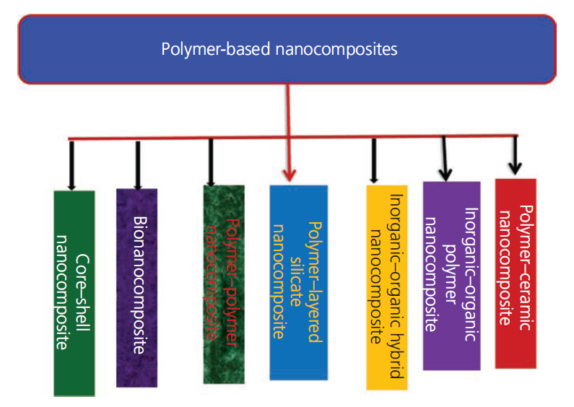
Polymer Nanocomposites (PNC’s)
PNCs may be classified into seven categories
■ polymer–ceramic nanocomposites
■ inorganic–organic PNCs
■ inorganic–organic hybrid nanocomposites
■ polymer–layered silicate nanocomposites
■ polymer–polymer nanocomposites
■ bionanocomposites
■ core–shell nanocomposites.

Slide 38
Carbon Metal Nanocomposites
Carbon nanostructures are among the most promising in nanotechnology because they can be used in different fields.
Composites derived from these nanostructures may exhibit mechanical properties, the electrical and thermal conductivities are useful for a variety of applications.
Carbon-based nanocomposites have witnessed a large volume of attention in the last two decades due to their structure-dependent electronic properties, low density, and large specific surface area.
Carbon-based nanocomposites contain different carbonaceous materials (graphite/ nanotube/ C60) as matrix with various reinforced phases such as metal oxides/ sulfides/ nitrides etc.
carbon Nanotube (CNT) based nanostructured composites have proven to be promising materials for application in electrochemical supercapacitors, gas and biological sensors, electromagnetic absorbers, and photovoltaic cells

Slide 39
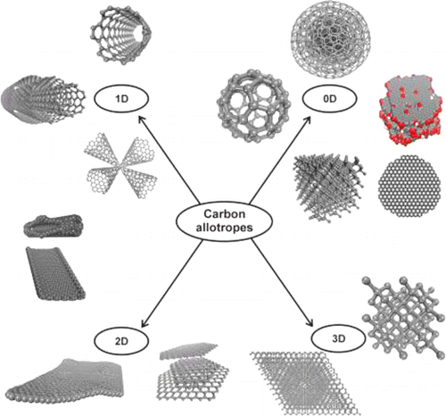
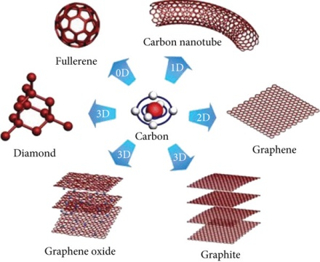
Carbon Metal Nanocomposites

Slide 40
Carbon Metal Nanocomposites
CNTs are among the most studied nanostructures in recent decades.
They are a few nanometers in diameter and form one-dimensional structures because the length is orders of magnitude larger than the diameter.
The great interest in CNTs is due to their outstanding properties, such as high mechanical strength and elasticity, chemical, thermal and structural stability, and high conductivity.
CNTs are formed only by carbon and have a cylindrical shape. The structure can be compared to a graphene sheet rolled into a tube shape in which the ratio between the length and diameter makes it almost a one-dimensional structure.
Single Walled Carbon Nanotubes have a simple cylinder structure, and Multi Walled Carbon Nanotubes consist of several concentric SWNTs. The length and diameter of the MWNT structures are very different from SWNTs, which implies differences in their properties

Slide 41
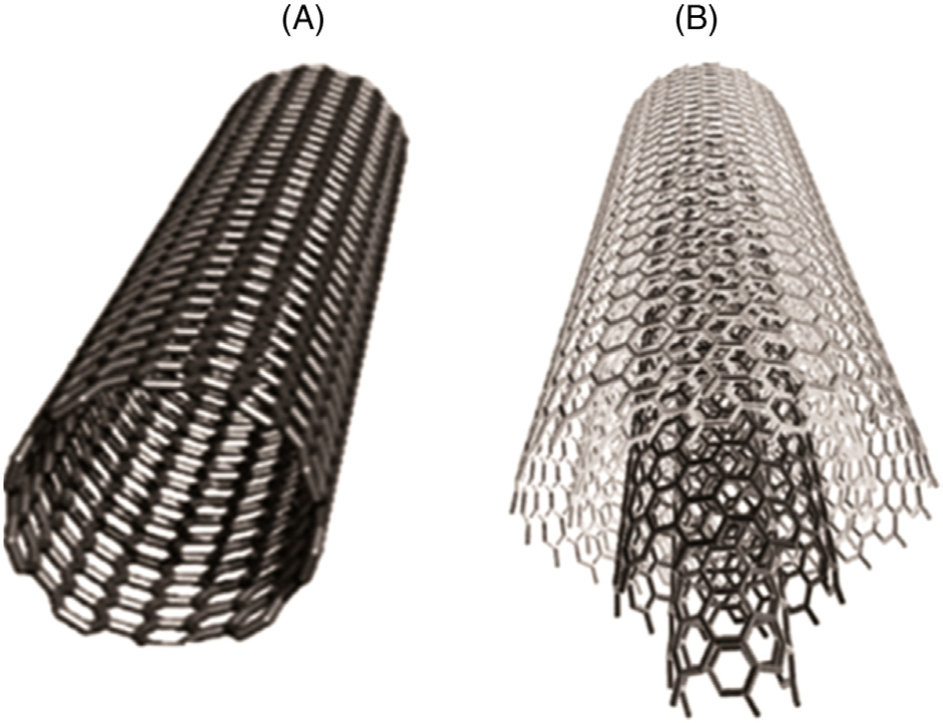

Slide 42
Carbon Metal Nanocomposites
CNTs are among the most studied nanostructures in recent decades.
They are a few nanometers in diameter and form one-dimensional structures because the length is orders of magnitude larger than the diameter.
The great interest in CNTs is due to their outstanding properties, such as high mechanical strength and elasticity, chemical, thermal and structural stability, and high conductivity.
CNTs are formed only by carbon and have a cylindrical shape. The structure can be compared to a graphene sheet rolled into a tube shape in which the ratio between the length and diameter makes it almost a one-dimensional structure.
Single Walled Carbon Nanotubes have a simple cylinder structure, and Multi Walled Carbon Nanotubes consist of several concentric SWNTs. The length and diameter of the MWNT structures are very different from SWNTs, which implies differences in their properties

Slide 43
Carbon Metal Nanocomposites
CNTs may be synthesized by several methods ranging from arc discharge to different Chemical Vapour Deposition (CVD) techniques, and even a significant industrial waste (especially from coke ovens in integrated steel plants) such as coal tar may also be used as the starting material for the same.
The present state of research on CNT-based nanocomposites revolves around the detailed understanding of supercapacitor behavior and the stability of CNT based metal oxides and CNT based polymers through the engineering of the structure-based parameter which involves composition, grain size etc., in addition to enhancing the electronic, mechanical, and thermal properties of these materials.
Owing to an excellent combination of thermal, optical, and electrical properties, CNTs turn out to be potential candidates in various newly-emerged fields, which commonly include nanotechnology and biosensors.

Slide 44
Carbon Metal Nanocomposites
Polymer reinforced CNT nanocomposites possess an excellent combination of mechanical properties and electrical conductivity for biosensor applications.
The composite electrodes composed of conducting polymers reinforced in CNTs results in an enhancement of mechanical strength along with thermal and electronic conductivity.
Activated Carbon CNT Nanocomposites yield much better results in terms of energy and power density.
AC has also been used extensively as an electrode material in Electric Double Layer Capacitors (EDLCs) owing to a remarkable combination of high capacitance, long cycle life, and most importantly, low cost of manufacturing.
Activated carbon (AC) is the most commonly used absorbent, primarily, owing to its high surface area.

Slide 45
Carbon Metal Nanocomposites
CNTs covalently bonded with carbon fibers may be applied for their high impact strength and stress.
CF/CNT based nanocomposites have found an extensive application in the context of lightweight automotive and aerospace components with high fuel efficiency.
CNTs have numerous advantages as conducting wires as compared to copper wires owing to their size and quantum effects.
Other than CNTs, other forms of carbon as amorphous and nanocrystalline carbon films, graphene oxide based nanocomposites, diamond like carbon (DLC) and Graphite like amorphous (GAC) based nanocomposites show a variety of applications in various fields.

